Slide 1
What can students teach us about inclusivity?

Slide 2
University of Derby
Post-92 university
Second most diverse university in the UK (HEPI, 2018)
16,300 students on campus (13,375 UG)
12% disabled students
67% over age of 21 (27% over the age of 30)
19% BAME

Slide 3
Introduction
Inclusivity is not about making retroactive adjustments to compensate students with particular needs
True inclusivity considers, plans for and delivers teaching and learning that supports all students to achieve to their potential
However, by considering the experiences of specific groups, we can learn much about the barriers to achievement that can prevent student success and identify steps to overcome those barriers

Slide 4
Our experience
Through research, by supporting students and in work with academic colleagues, we have witnessed and helped to identify changes in practice that can benefit all students
This session will focus on three examples
Language
Belonging
Assessment

Slide 5
Potential language barriers
We know that ambiguous language can cause particular problems for some students e.g. those with Autism and dyslexia
Deaf students and students with a hearing impairment can often find complex language difficult to access because it is being expressed in their second language
We know that WP students are more likely to arrive at university without complex academic language
We know that language that is not understood, can cause anxious reactions that prevent students from being able to engage with the underlying concepts

Slide 6
Required language
However, to be able to engage with academic learning at HE level, students must acquire relevant academic language
Simply ‘dumbing down’ subject language or the language of education is actually not helpful
Providing proactive support to ensure that all students can acquire the necessary language will provide a platform for success

Slide 7
Types of language
Subject language – specific terminology
Learning language – that describes learning tasks and practices (essay, report, seminar, lecture etc.)
Internal language – the language of the organisation (EECs, AEDs, Referrals etc.)

Slide 8
Practices that can help
Glossary of terms
Scaffolded introductions to subject material
Meta exercises that task students to find definitions
Distinguishing between complex language that is necessary and language that excludes unnecessarily

Slide 9
Belonging
Students with Autism report feeling overwhelmed during transition by the unfamiliarity of the environment, the complexity of negotiating new relationships and the significant changes to their usual daily routines
BAME students, mature students and international students also report that they often find the new university environment alienating

Slide 10
The need for belonging
Decades of research have shown that social integration and ‘sense of belonging’ are crucial to student persistence and success
Our research suggests that the majority of students have a pre-occupation with socialisation on entry and recognise the positive and negative impact it has on them
In large part, universities often trust that students will somehow integrate, despite the barriers that exist

Slide 11
Practices that can help
Structured, purposeful social activity during induction, in which students are not left to negotiate ‘unseen social rules’ by themselves
Activities that focus on the diversity of the cohort and recognise it as a strength – continuing to keep groups fluid to prevent isolation
Activity that familiarises students with the environment quickly
Assigning groups and roles in group work and meta group work practices

Slide 12
Assessment
Particular types of assessment can be more of a barrier to some groups than to others
Female students achieve disproportionally less on exams
Students with Autism often find it difficult to speak in public
Students with fluctuating health can be penalised by single point assessment

Slide 13
Academic Requirements
Student achievement and wellbeing requires that students are stretched and challenged
When students are taught and assessed in their “preferred style,” evidence suggests that they learn less
Assessment should drive students to learn beyond the ‘basics’

Slide 14
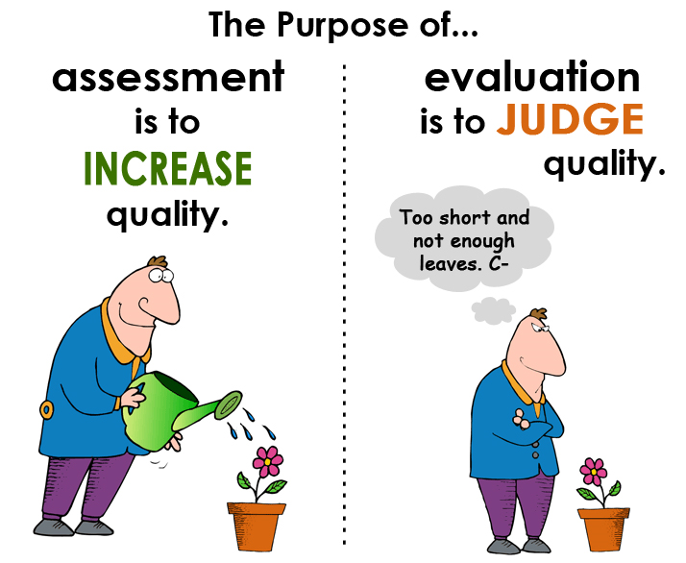
Practices that can help
Mixed modes of assessment across the curriculum
Some level of assessment selection for all students
Scaffolded curriculum that focusses on learning over assessment
Support to develop missing skills, confidence and belief

Slide 15
Finally
Considering the needs (not wants) of all students can benefit all
But considering how you can help students with the most obvious needs can be your guide
Perfect inclusivity is not possible – this is about having a classroom of individuals. But open conversation about diversity and inclusivity will create a culture that is inclusive and challenging

Slide 16
Exercise
In groups
Identify another theme or subtheme where you believe we can learn from specific student groups. Discuss what you think we might learn and what the implications of this might be, e.g. Knowledge delivery, Technology in the classroom or Work placement. We will then feedback to each other.
In reporting your task
Identify your theme
Identify problems specific groups of students may experience
Identify what you think might help – and how this might help all students

